Slide 1
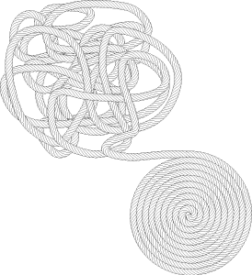
Where’s my Architecture?
Chris Chedgey
Structure101

Slide 2
Discovering/defining architecture
Real architecture
Existing codebase structure
Well-structured containment
Creating well-structured containment
Levelization
Making it real
+ Examples

Slide 3
Structure101 Overview
About Structure101 Inc.

Slide 4
About Structure101 Inc.

Slide 5




Structure101
Since 2000/2007
Team in Ireland, France, India, Spain, Canada, …
Web+channel sales
“Structure101 shaved months of calendar time and man years of effort off the project”
Bill Jackson, Netflix
Notes:
4 monthly meetings

Slide 6
Why Structure?
“Well-structured software is delivered in half the time,
at half the cost, with 8x less bugs”
US Air Force study.
When a codebase grows beyond a certain size, without a guiding architecture, developers start drowning in an expanding sea of source files
This is a huge, pervasive driver of cost which impacts all development activities
Discovering defining an architecture for an existing code base is a much lower cost and risk than struggling on… or starting over
But this has required a new kind of tool → Structure101

Slide 7

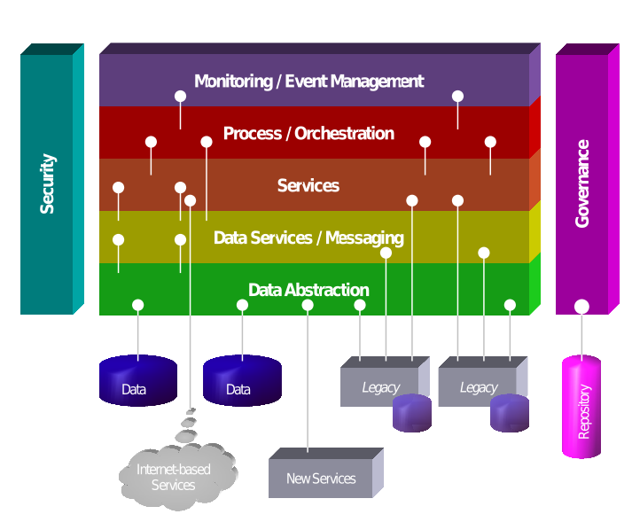
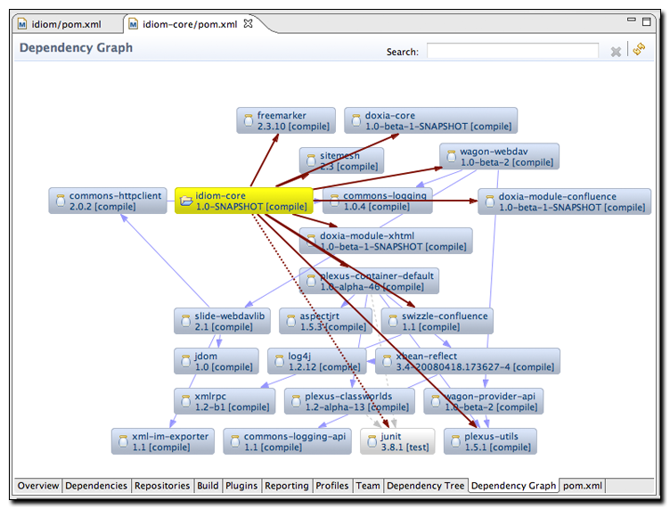

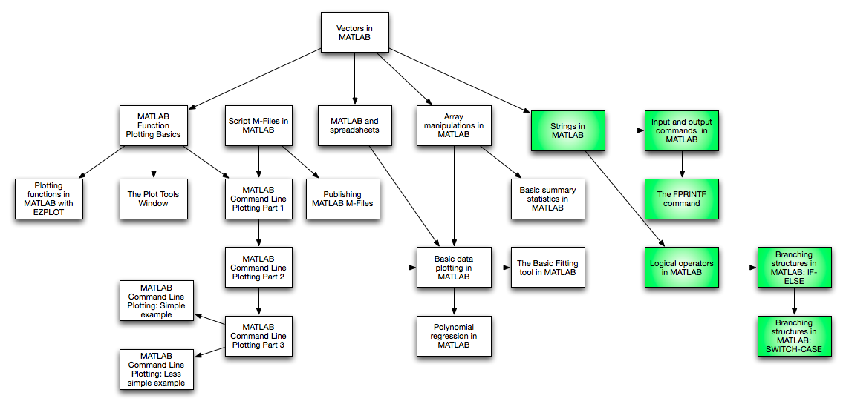
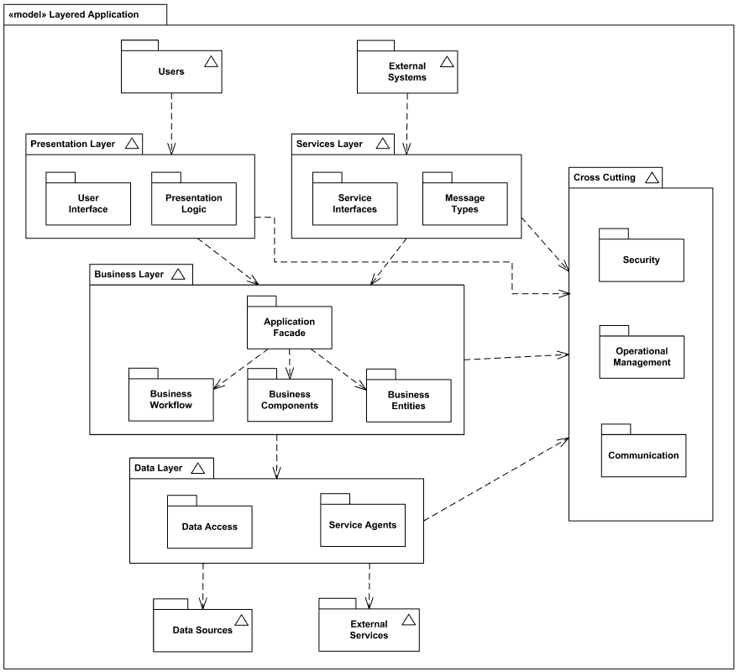
Architecture – organizing complexity
Well organized containment model
Inter-container dependency rules
Real?
Maps to code
Validated

Slide 8
Real Architecture
Map/blueprint for developers
Phased testing and release
Divide work across organizations, teams, individuals
Modularity: interfaces + info hiding
Reuse or replace subsystems or layers
Impact/regression control
Help new developers
…
Agile Engineering

Slide 9
Controlling Architecture
New project
Define architecture that maps to the evolving codebase
Communicate, enforce, evolve
Existing codebase
Discover/define architecture that maps to the evolving codebase
Communicate, enforce, evolve

Slide 10
The structure of existing codebases
What do we have? What do we need?

Slide 11
The structure of a codebase

Slide 12
What we have (raw material)
1. Implementation
Thousands of source files
Countless interdependencies
Not an “architecture”

Slide 13
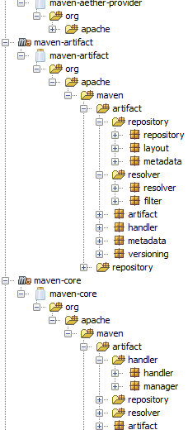
What we have
2. Physical organization
Packages, jars, Maven projects, …
Helps to find files
But is it an “architecture”?

Slide 14
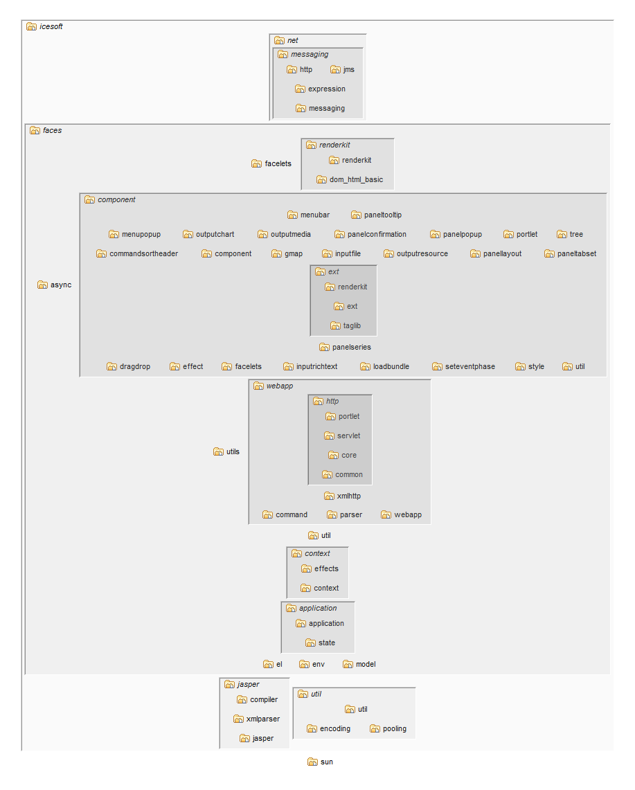
What we have
2. Physical organization
Packages, jars, Maven projects, …
Helps to find files
But is it an “architecture”?

Slide 15
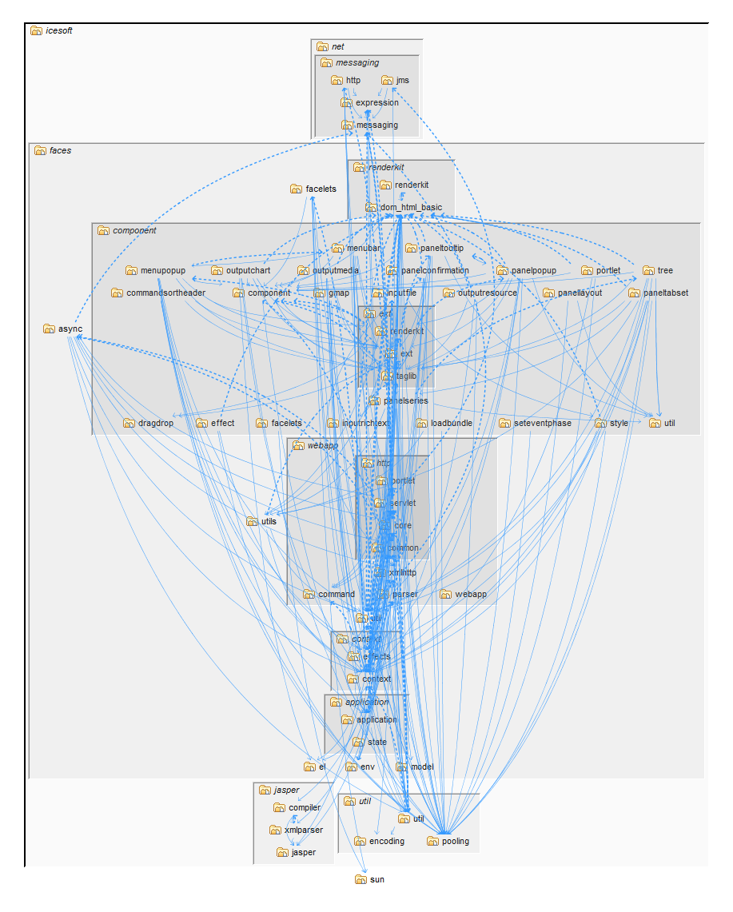
What we have
2. Physical organization
Packages, jars, Maven projects, …
Helps to find files
But is it an “architecture”?
Not usually an “architecture”

Slide 16
What do we need from an “architecture”?
Agile development
Divide work across organizations, teams, individuals
Phased testing and release
Protect internal interfaces
Reuse or replace subsystems or layers
Impact/regression control
Help new developers
…
2. Physical
organization
1. Implementation

Slide 17
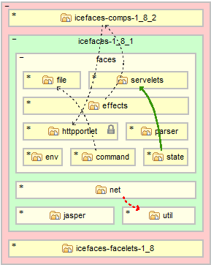
What do we need?
Well-structured containment model
Low/controlled dependency
Defined rules
Defined layering/visibility
Real
Communicated
Maps to code
Automatically checked/enforced
Evolves with codebase
3. “Architecture”
2. Physical
organization
1. Implementation
Conform
Align
Maps

Slide 18
What do we need?
3. “Architecture”
Well-structured containment model
What is it?
?

Slide 19
What do we need?
3. “Architecture”
What is it?
How do we get it?
How do we make it real?
?
Conform
Align
?

Slide 20
Structure101 Overview
What is “well-structured containment”

Slide 21
“Well-structured containment”

Slide 22
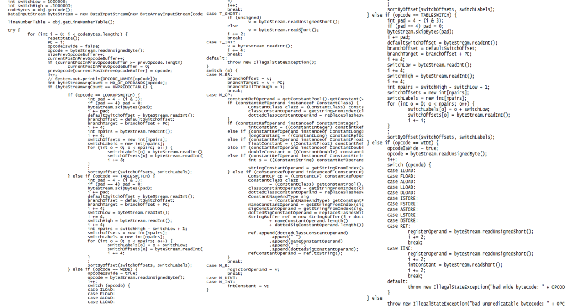
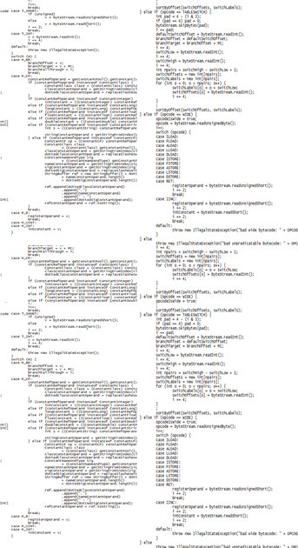
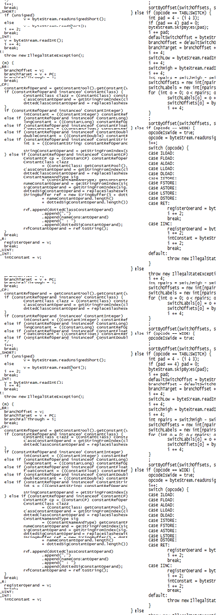
Containment
Divide and conquer
Code → method → class → package → subsystem → …
“Fat” = too much in one place
Grow and divide

Slide 23
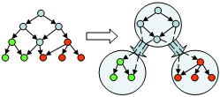
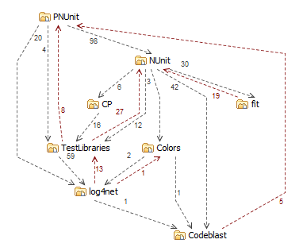
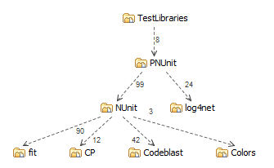
Containment creates dependency
Different containment
Very different dependency
Containment is key to controlling dependency
Containment model 2
Containment model 1

Slide 24
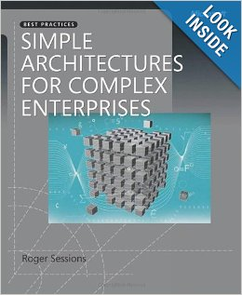
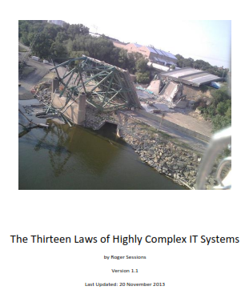
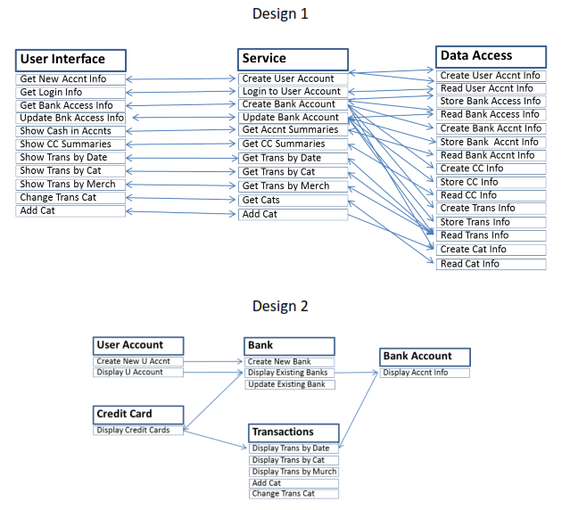
Dependency creates complexity Roger Sessions:
Law 3. Complexity is driven by interdependencies.
Law 10. Complexity is an undesirable architectural attribute of an IT system.
Reliability: Most IT failures are due to complexity.
Auditability: complex systems are extremely difficult to audit for regulatory compliance.
Security: complexity increases the chances of fraud and vandalism.
Alignment: complexity results in poor alignment between IT systems and business needs.
Cloud: complexity results in inefficient use of cloud resources.
Maintainability: complexity makes system maintenance much more difficult.
Agility: complexity makes change much more difficult.
Scalability: complex systems are hard to scale up when user demand exceeds expectations..

Slide 25
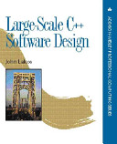
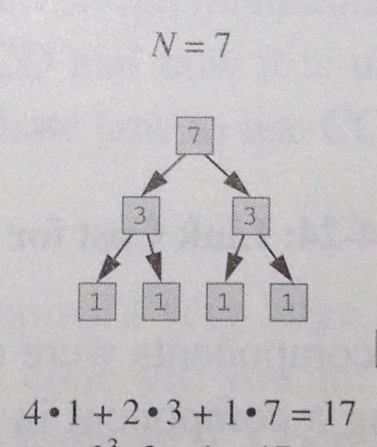
Dependency is cumulative
“In software architecture,
resource constraint is not the big expense right now...
it's coupling”
-Neal Ford, Thoughtworks
“Law 8. Complexity increases exponentially”
-Roger Sessions
Cumulative Component
Dependency (CCD)
- John Lakos

Slide 26
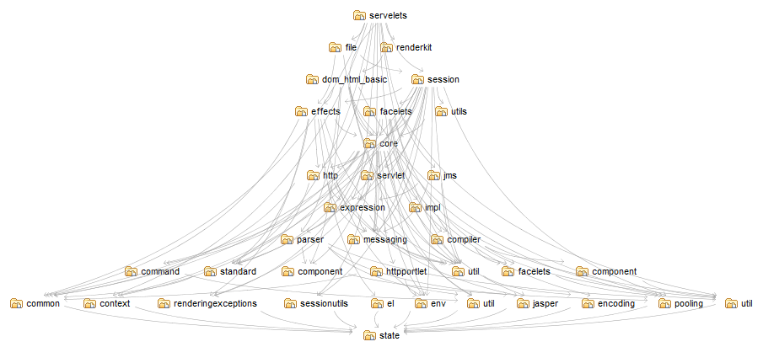
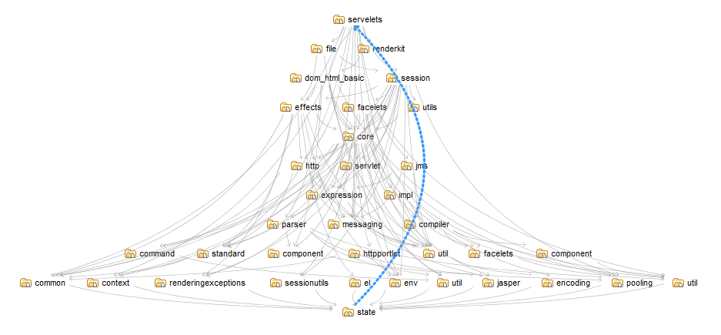
Cycles explode dependency
“Cyclic dependencies have
the greatest capacity to
increase the overall cost
of developing and
maintaining a system”
- John Lakos
CCD = (1*1) + (11*2) + (7*3) + …
< 164
CCD = 36²
= 1,296 !!!

Slide 27
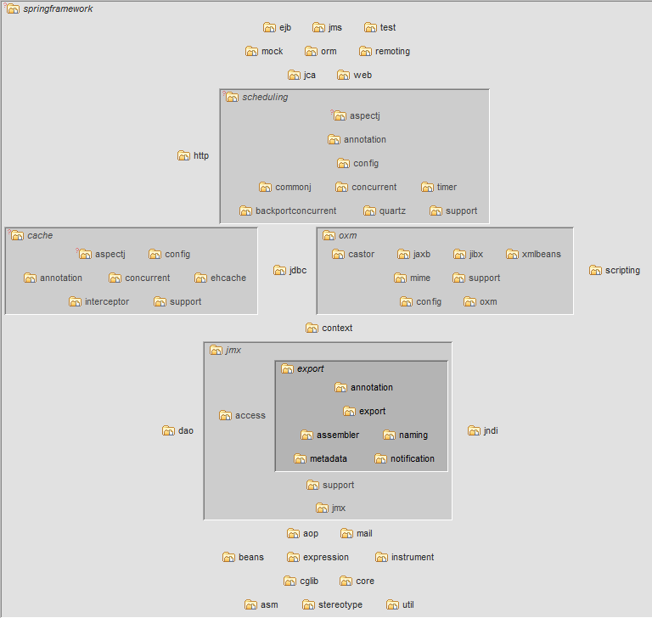
So “well-structured containment” is…
No “tangled” containers
No “fat” containers
… a foundation for “architecture”
Modules/Rules
Communication
Enforcement
Controlled evolution

Slide 28
Structure101 Overview
How do we get
“well-structured containment”

Slide 29

How do we get it?
“Well-structured containment”
?

Slide 30
“Well-structured containment” is…
Hierarchical organization
No “fat” containers
No “tangled” containers
… a foundation for “architecture”
Dependencies

Slide 31
Raw materials
Physical
organization
Implementation

Slide 32
Using source files
Recursively group cohesive clusters of files
Bust or isolate large file-level tangles
Can be partly automated
Implementation

Slide 33
Using physical organization
Restructure/refactor
Disentangle
Preserve familiar structures
Guided/manual reorganization
Can be harder
Physical
organization
Implementation
Notes:
A structured codebase is a great milestone
Much easier to work with
Measurable – keep it structured
Easy to strengthen modularity, define architecture

Slide 34
Draw on both implementation and existing physical organization
Use the physical organization where it is reasonably well-structured
Build a new structure where it isn’t
Physical
organization
Implementation

Slide 35
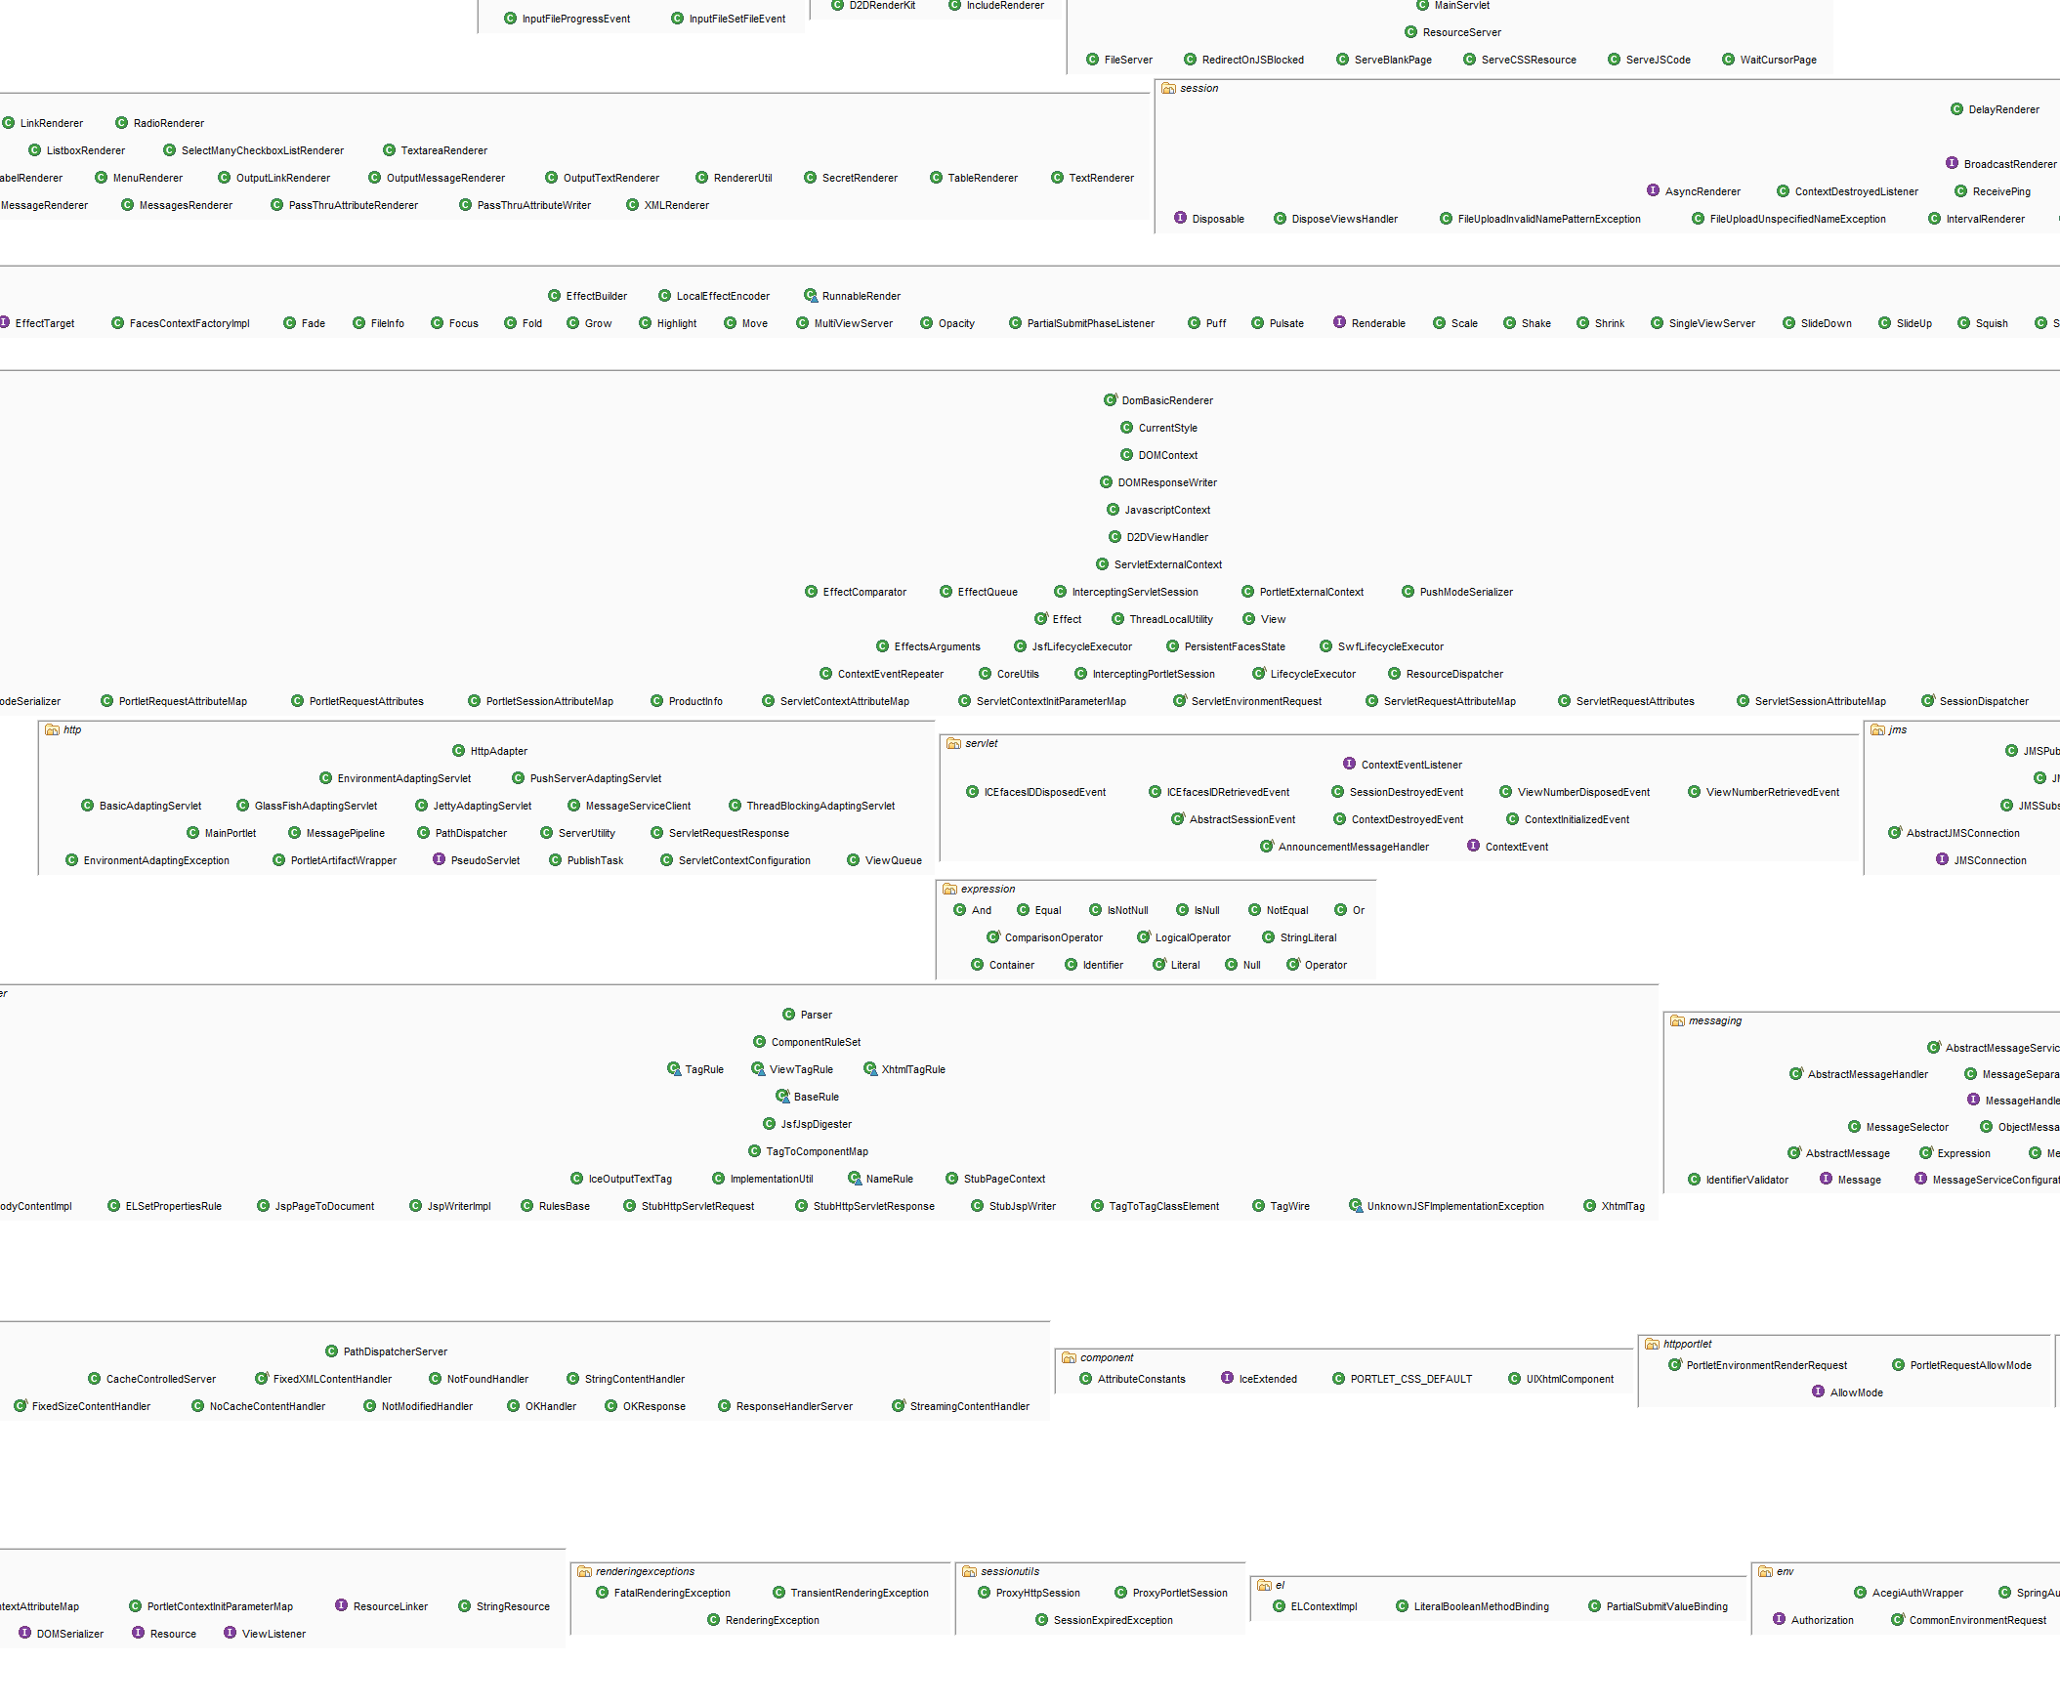
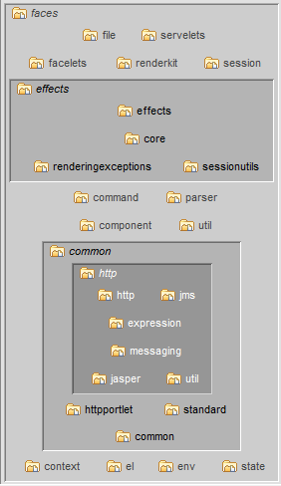
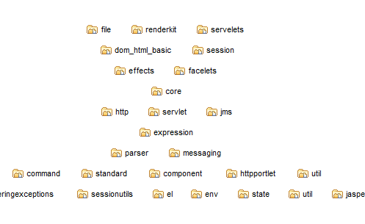
Building containment from implementation up
Find “cohesive clusters” of source files
(use automation)
Wrap them into containers
Find cohesive clusters of containers
Wrap them into higher level containers
Repeat

Slide 36
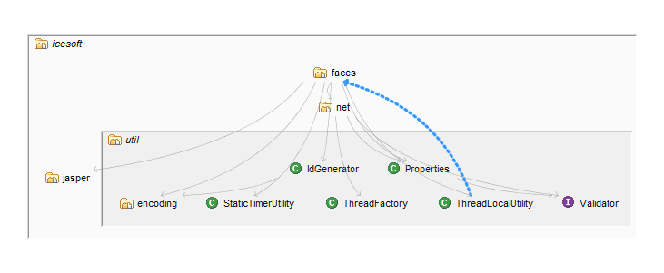
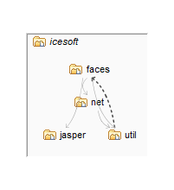

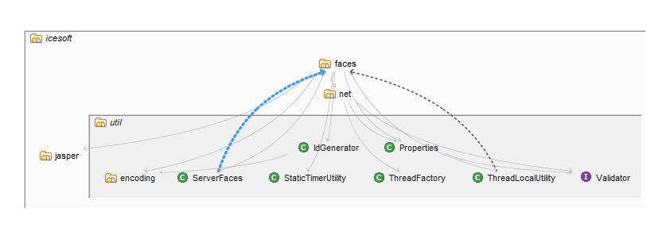
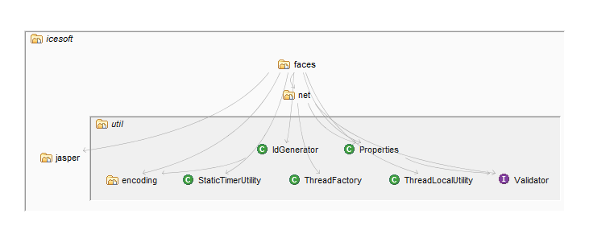
Restructuring physical organization

Slide 37
Key concept: Levelization
Cutting through the detail

Slide 38
Key concept: Levelization

Slide 39
Why Levelization?
Concise way to lay out dependent items
Intuitive to understand without displaying all the details
Details can be displayed when needed
Ideal for manipulating containment structures
Exposes cycles in a way that makes them tractable
Supports the presentation of other patterns, e.g. cohesive or disconnected clusters
Makes structural manipulation possible

Slide 40
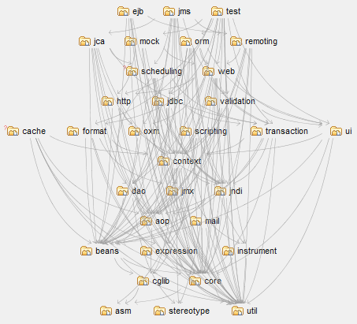
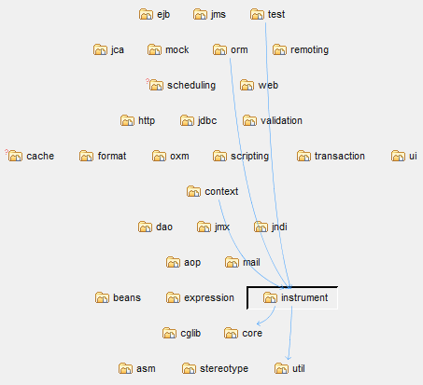
Levelization
Layout + goal
Items on the bottom row depend on nothing
Items on every other row depend on at least one item on the row below
Much dependency information without displaying all dependencies
Selectively show dependencies as needed
Dependencies

Slide 41
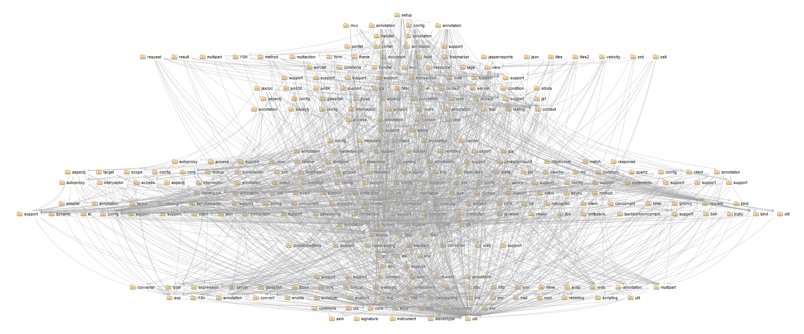
Levelization

Slide 42
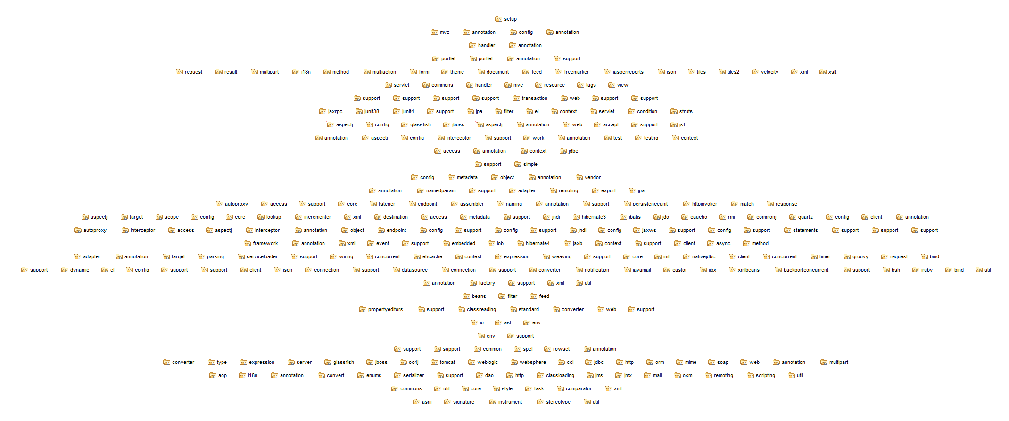

Levelization
Dependencies
Levelizable

Slide 43
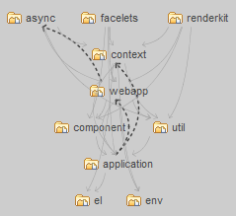
Levelization “Minimum Feedback Set (MFS)”
Cyclic dependencies
Smallest set of upward dependencies
Main flow of dependencies is still clear

Slide 44
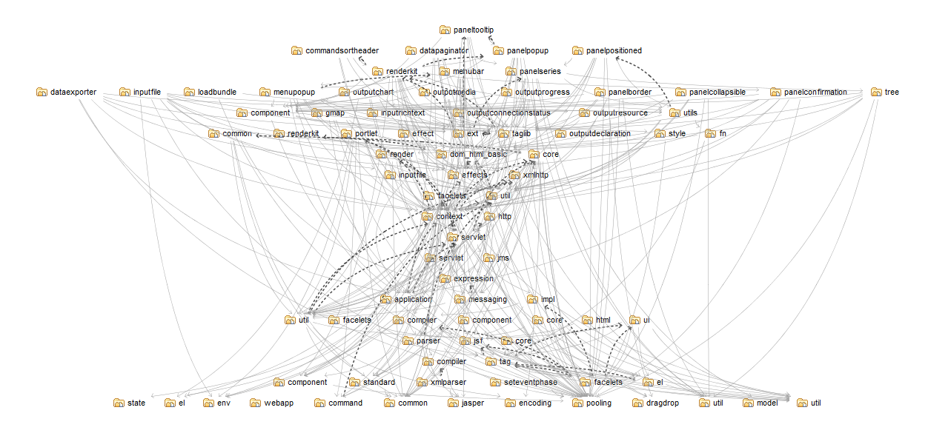
Levelizing the unlevelizable

Slide 45
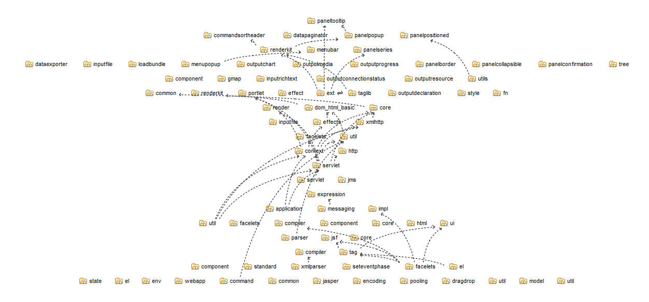

Levelizing the unlevelizable
Levelizable

Slide 46
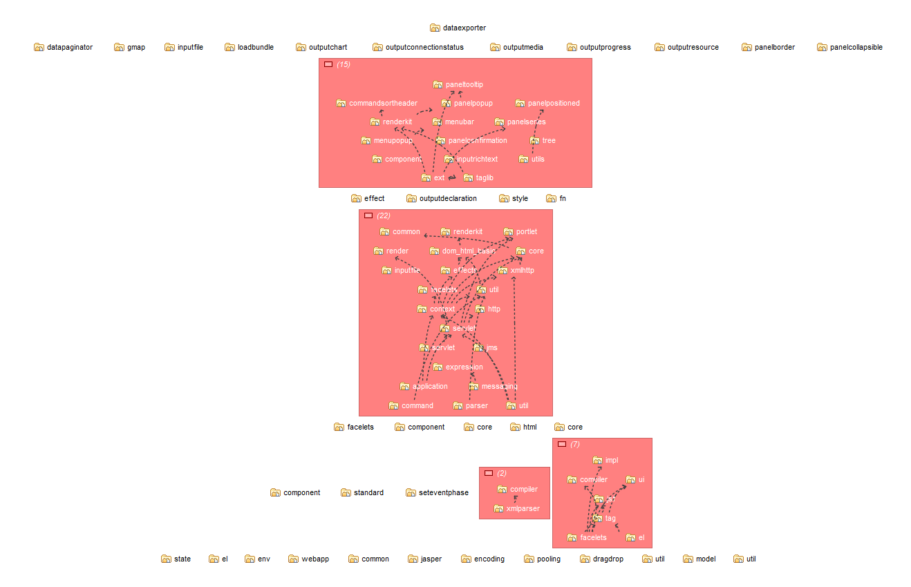
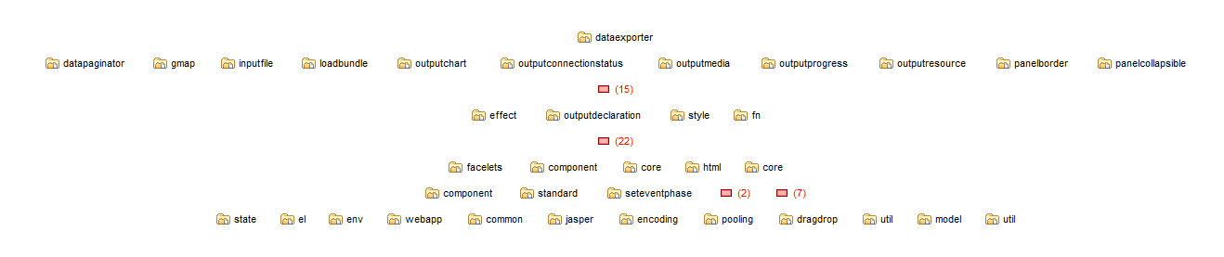
“Tangle” - Every vertex reachable from every other vertex
Levelizable
Levelizable

Slide 47
Structure101
Making it real

Slide 48
Making it Real
Structure101

Slide 49
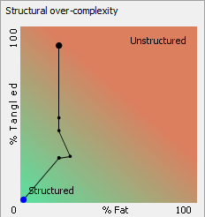
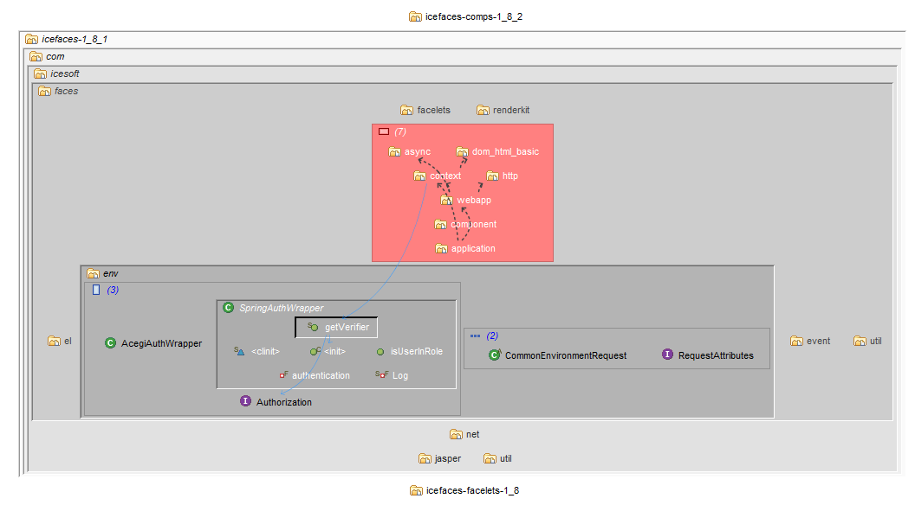
The Levelized Structure Map (LSM)
Designed specifically for containment modelling
Expand/collapse depth of scope
Auto-groups tangles, cohesive clusters, disconnected clusters
Filter items and dependencies to reduce noise
Can be manipulated interactively or automatically to create well-structured containment model
Items are always levelized at every scope and after every change

Slide 50
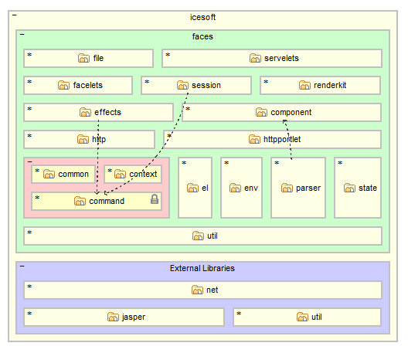
The Architecture Diagrams
Communicate important aspects of model with team
Define rules for a containment model
Cells map to code by patterns
Dependencies should flow down
Cell positioning expresses many rules, visually, intuitively
Can have many diagrams
You define layering and visibility – not changed automatically
Used to check code changes at edit and build times

Slide 51
Step 1: Discover and define your architecture
Bootstrap step
Use LSM to create “well-structured containment model”
Get “Fat” and “Tangles” close to zero
Use the Architecture diagrams to define dependency rules for your model
Share your architecture

Slide 52
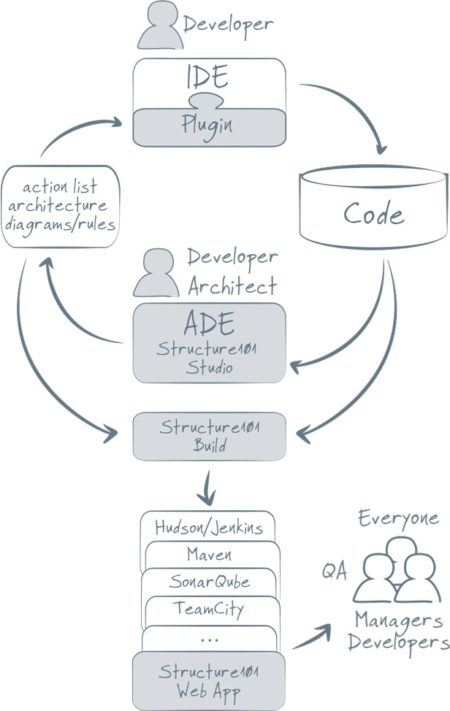
Step 2: Architecture-guided development
Communicate
Compile-time checking
Build-time checking
Reporting
Evolve
Update architecture when required
Adjust architecture ahead of development

Slide 53
Licensing
Structure101 Studio
$1190 (per architect)
Structure101 Build
$1495 (per build server)
Plugins
Maven, Sonarqube, Hudson/Jenkins, Eclipse, IntelliJ
Structure101 Webapp
No charge

